Slide 1
Predicting satisfaction among the students on e-learning under the pandemic situation
Sajidh Ahamed
219305A

Slide 2
Data and Descriptive statistics
Questionnaire was distributed online using Google forms among undergraduate students..
Questionnaire has designed into 4 parts
Demographic information
Learners satisfaction
Technological impact
Lectures/Instructors impact in e-learning
72 responses were collected over a month period. (12-Oct to 13-Nov 2021)

Slide 3
Undergraduates from 16 institutions responded where 61.1% is from University of Colombo.
Respondents were from 16 districts where Kandy has 18 response as highest and colombo has 16 as next. Then kegale, Kurunegala and Matara follows with 7 responses each.
Most student uses WiFi or Both Wifi and Mobile data.

Slide 4
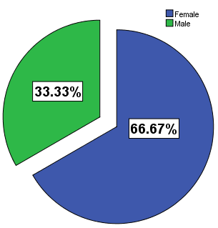
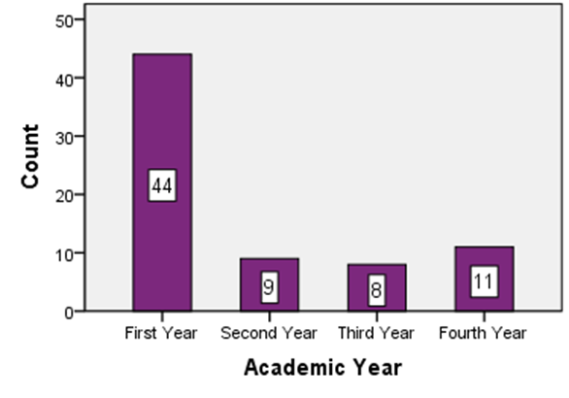
⅔ of respondents are female.
Majority of the respondents are first year undergraduate students.

Slide 5
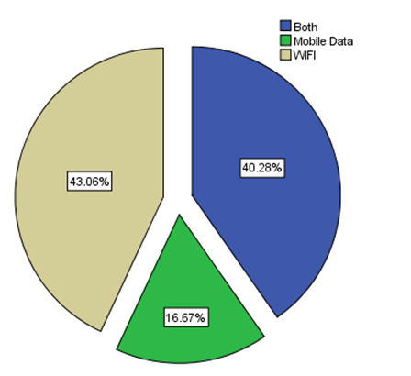
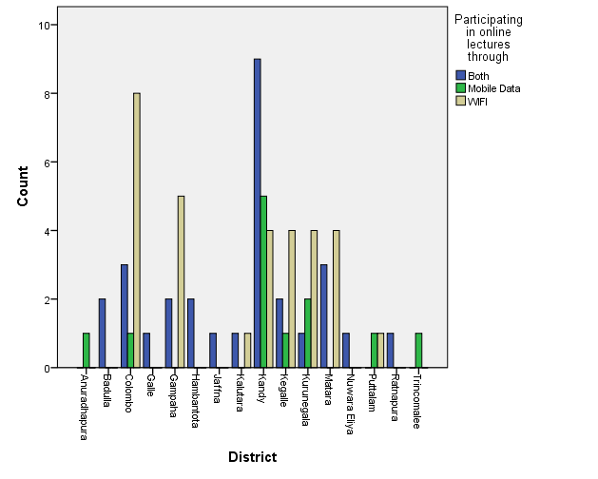
16.7% of the respondent who rely on the mobile data while majority use either WIFI only or combination of WIFI and Mobile data.
Students who live where infrastructure is developed mostly uses WIFI for their only activities.Whilst students in Anuradhapura and Trincomalle uses only the mobile data.
Increase the sample size would give us more accurate information.

Slide 6
Coclusions
Cronbach’s Alpha of total question of 37 is 0.914 which indicates the reliability of the questionnaire.
All of the sub sections also give Cronbach’s Alpha of greater than 0.79.
Factor | Average Ratings
Factor 1 – learners perspective | 3.4417
Factor 2 – technological impact | 3.7130
Factor 3 – lectures impact | 3.9947
Overall | 3.7164
On Average Students were satisfied with the online education and mostly they are satisfied with how lectures explain and conduct the lectures via online platforms.

Slide 7
Conclusions cntd.
Average satisfaction among males and females are not significantly different.
Average satisfaction among students who uses WIFI, mobile data or both are not significantly different.
Average satisfaction among years of study are not significantly different.

Slide 8
Methodology
Initially data was taken and preprocessed.
Then descriptive analysis was carried out to understand the data and its characteristics.
Cronbach’s Alpha was calculated for overall questions and each category separately.
Some of the hypothesis were tested among the dataset for means of satisfaction level.
Whether satisfaction of e-learning affected by gender, the mode of internet connection or their year of study.

Slide 9
Hypothesis 1
H0: Mean satisfaction levels of male and female are equal
H1: Mean satisfaction levels of male and female not equal
Hypothesis 2
H0: Mean satisfaction levels of using internet are equal
H1: Mean satisfaction levels of using internet not equal
Hypothesis 2
H0: Mean satisfaction levels of year of study are equal
H1: Mean satisfaction levels of year of study not equal

Slide 10
Discussion
Respondents were request to response about their satisfaction level of e-learning under 3 category.
Cronbach's Alpha was calculated to check the reliability of the questionnaire.
The mean satisfaction levels of gender, mode of internet use and year of study were compared to identify whether there is any difference in satisfaction level.
It is observed that overall score of 3.7164 indicates that student are satisfied with e-learning.
When comparing the mean significant level of satisfaction on some variables like Gender, mode of internet usage and year of study, it is noted that the mean level does not significantly differ.
Increasing the sample size would give more information on these inferences.

